Slide 1
Generating Personalized Emails with GPT-2
Group O: Yun Cao, Yue Liu, Muyang Cheng, Nan Chen

Slide 2
Introduction

Slide 3
Personal Emails Generation
This project aims to create an effective communication tool that can help establish connections on platforms like LinkedIn. We trained a model using GPT-2 to generate personalized emails based on user inputs.
Task: Text Generation
Model: postbot/distilgpt2-emailgen-V2
Dataset: LightTai/personalized-email
Libraries: Transformers, datasets, torch, scikit-learn, accelerate

Slide 4
Main Problem
How to train our model to generate personalized emails?
How to use our model?
How to evaluate our model?
How to avoid misuse of our models and ethical considerations?

Slide 5
Analysis and Findings

Slide 6
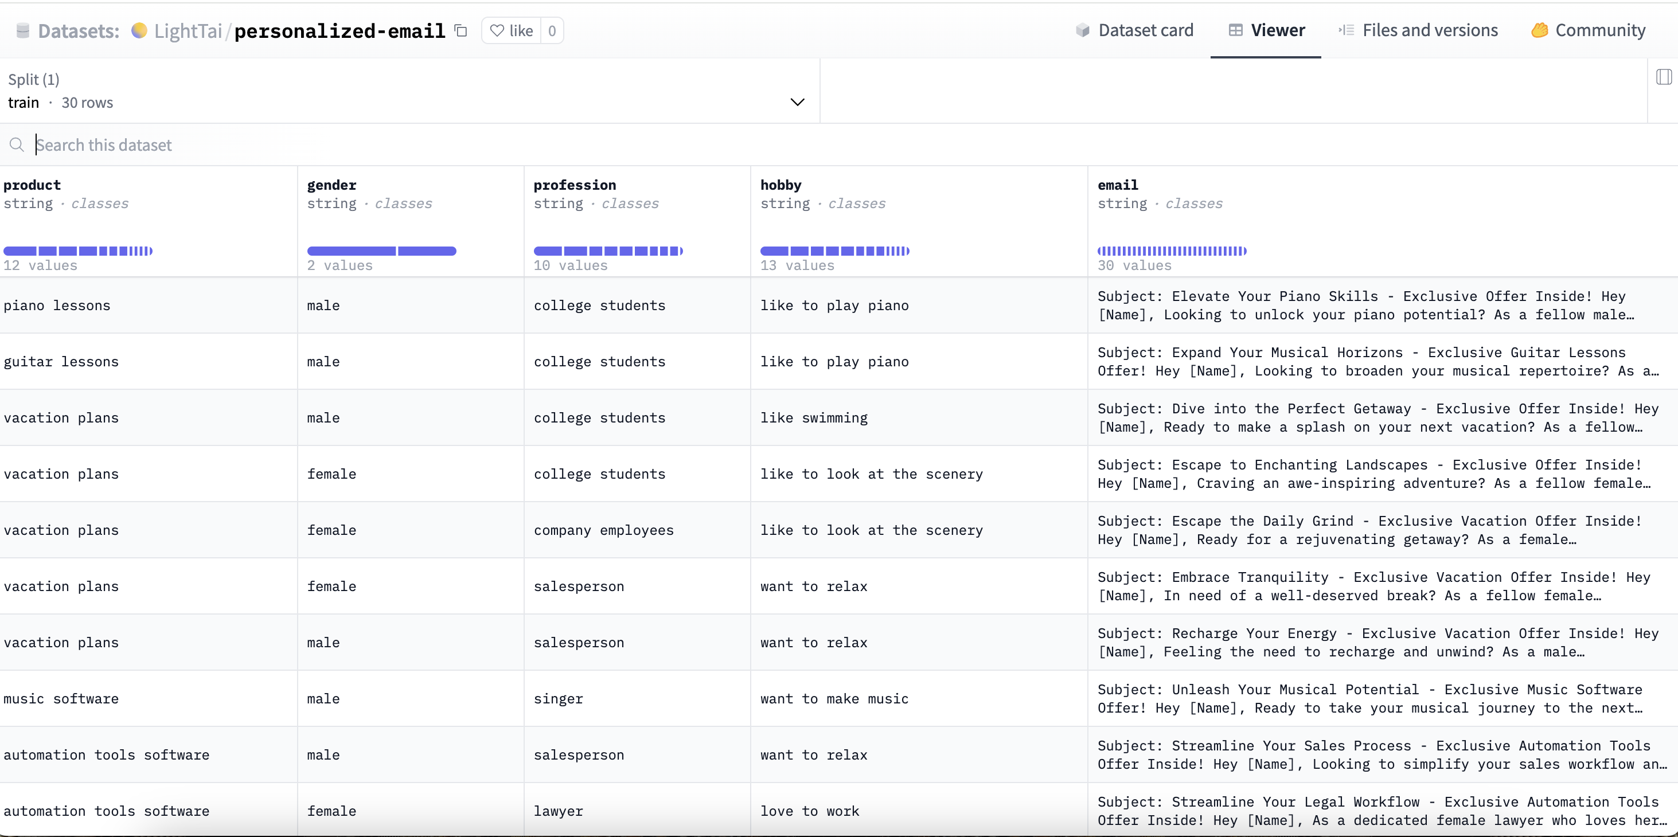
Model
Data Analysis

Slide 7
Model
NLP Methodology and Techniques Employed
Text Classification/Segmentation: To analyze the customer base and categorize it based on different attributes such as gender, profession, and hobbies. This would involve supervised learning algorithms that could classify text into pre-defined classes based on the training data provided in the dataset.
Sentiment Analysis: To understand the sentiment behind the hobbies or professions listed, which might then influence the tone and style of the email content.
Template-Based Text Generation: For generating personalized emails, a template-based approach would be used. Templates would have placeholders for names, professions, products, etc., that would be dynamically filled based on the customer data.
Feature Extraction: Before any text generation, it would be necessary to extract features from the text that are relevant to the product, gender, and hobbies, and use them to tailor the content of the emails.
Data Preprocessing: Cleaning and organizing the data to ensure the NLP models work efficiently. This would include tokenization, stemming, lemmatization, and removal of stop words.

Slide 8
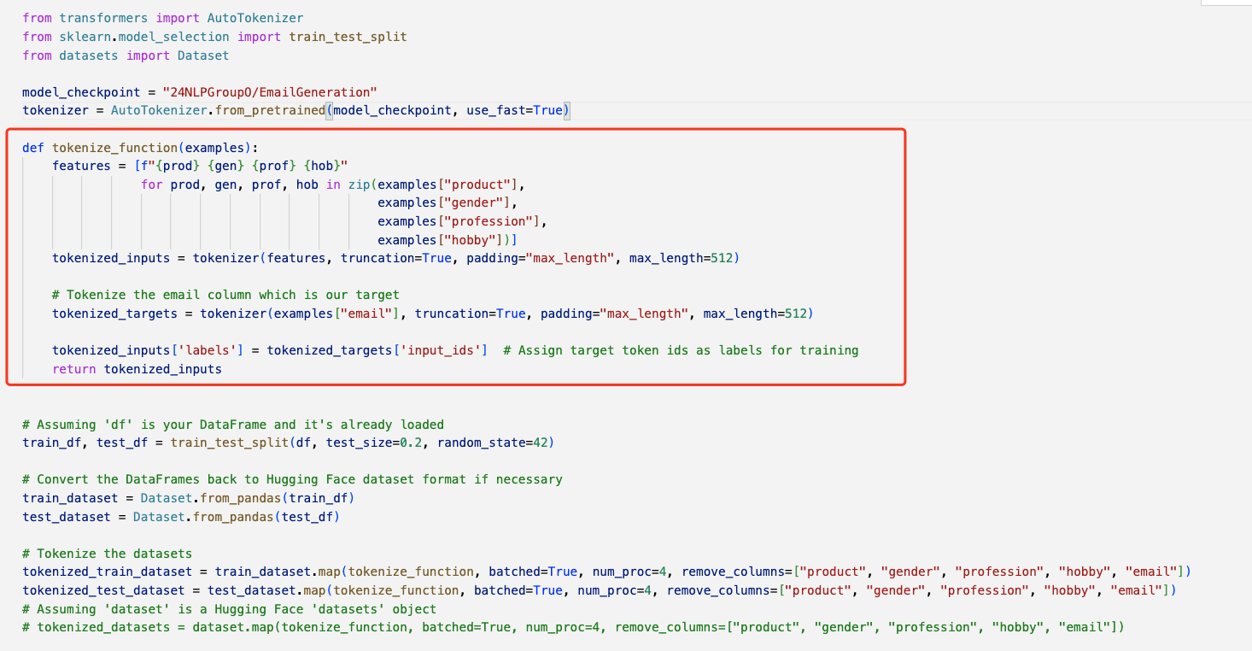
Model
Explain Dataset to Model Tokenize

Slide 9
Model
Explain Dataset to Model Tokenize
Loading Pre-trained Model Tokenizer: An AutoTokenizer is loaded with a specified pre-trained model checkpoint. The tokenizer is a crucial tool that converts text data into a format that can be processed by machine learning models.
Tokenization Function: The function tokenize_function is defined to tokenize the inputs. It takes examples from the dataset and extracts the product, gender, profession, and hobby columns. These columns are tokenized, meaning they are converted into a sequence of numbers that represent the text in a way the model can understand. There's a special focus on the email column since it is the target variable (what the model will learn to generate).
Processing the Dataset: The dataset is split into a training set and a test set with a 50/50 split. The original DataFrame is then converted into a Dataset object, which is a more efficient format for handling datasets in machine learning workflows.
Tokenizing the Dataset: The actual tokenization process happens where the training and test sets are mapped with the tokenize_function. This means that all the text data in these datasets is converted into tokens.

Slide 10
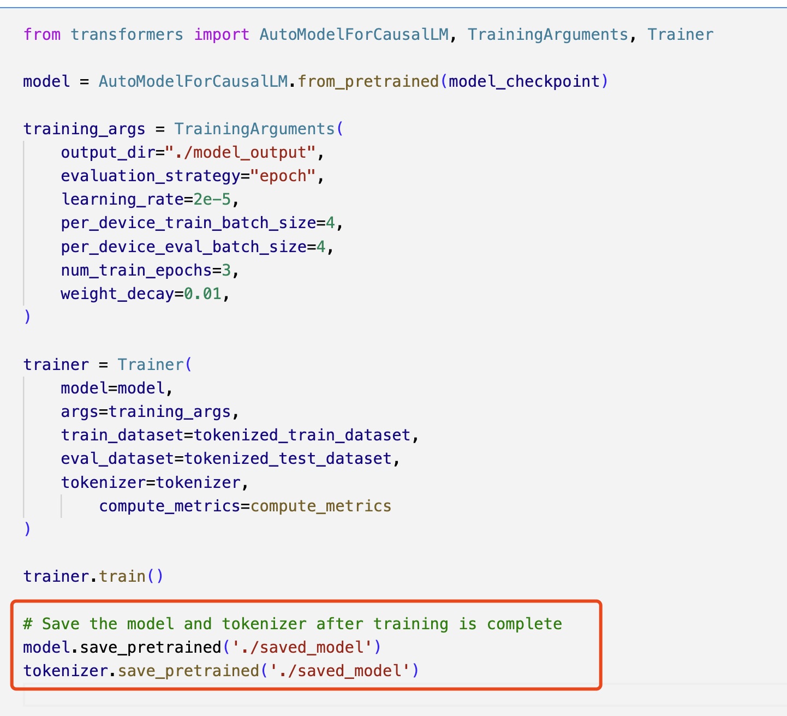
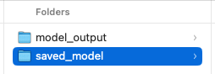
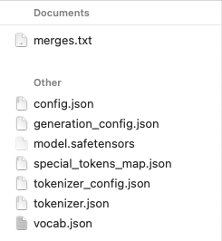
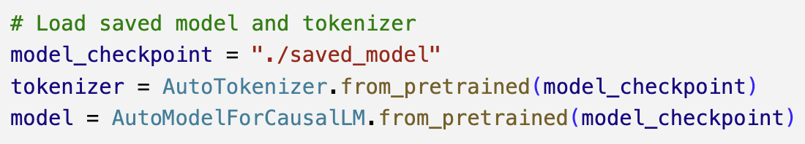
Model
Save and Load Model

Slide 11
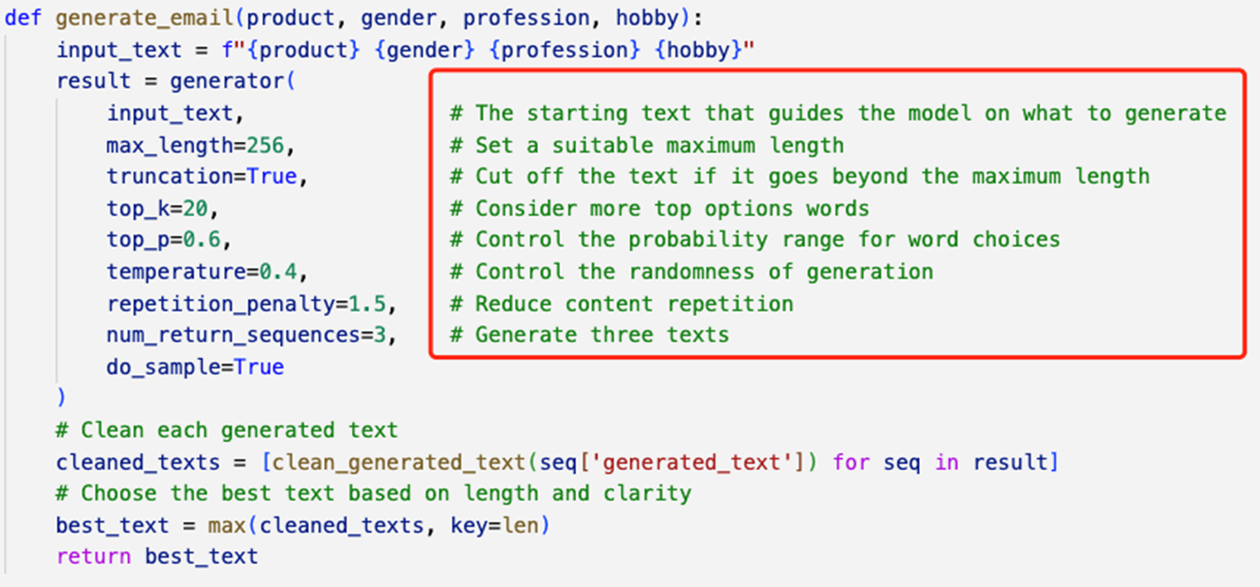
Model
Parameters

Slide 12
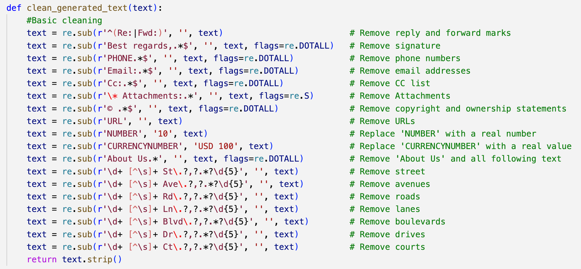
Model
Basic Clean

Slide 13
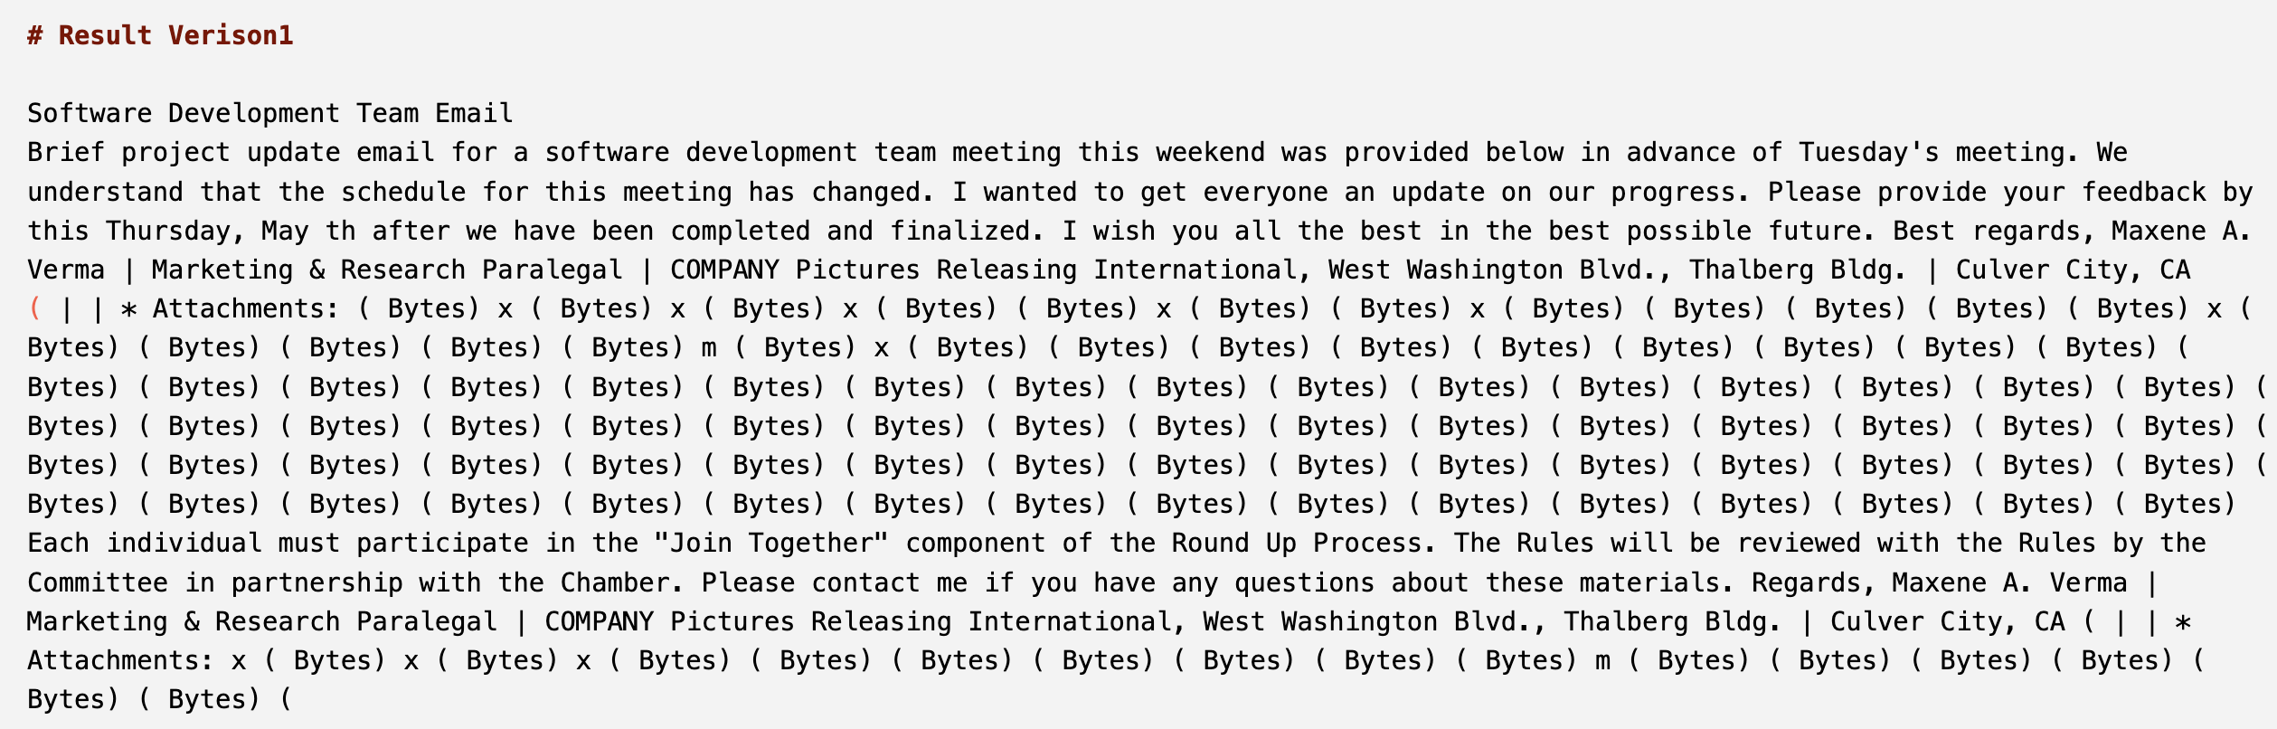
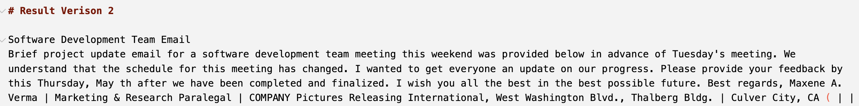
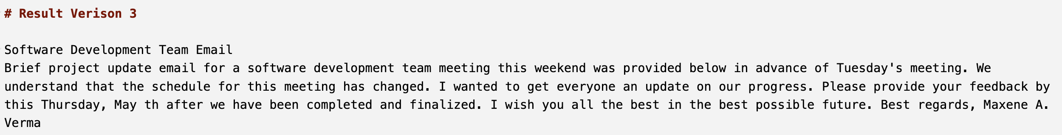
Model
Comparison of Out Put

Slide 14
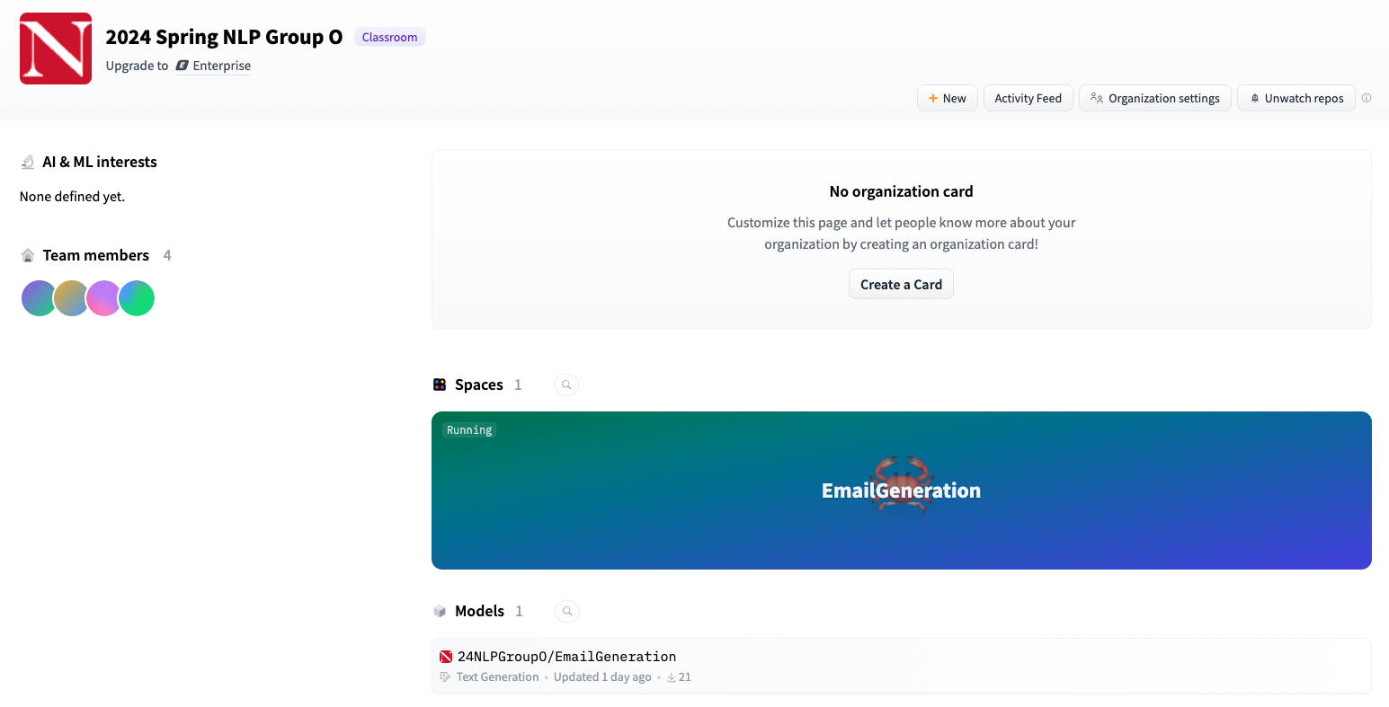
Usage

Slide 15
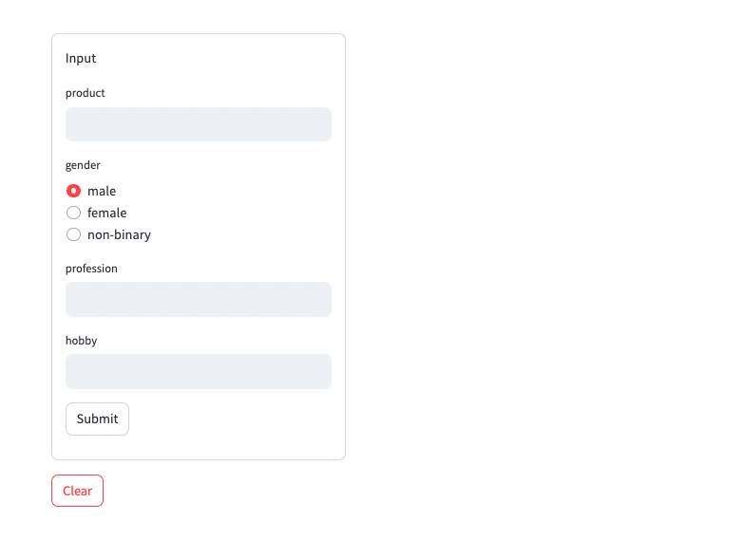
Usage

Slide 16
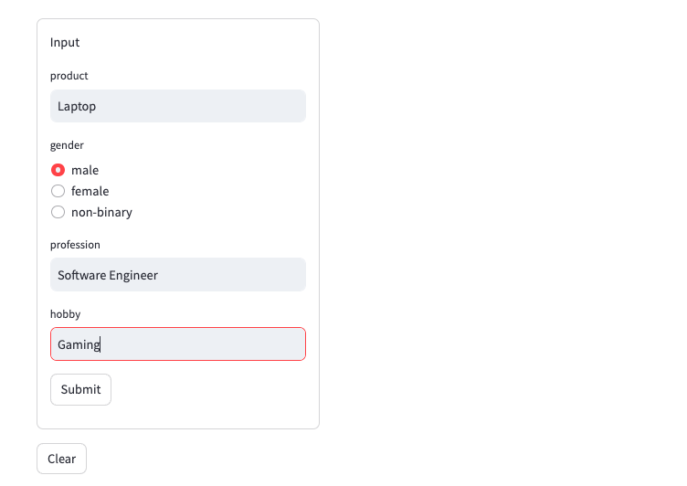
Usage

Slide 17
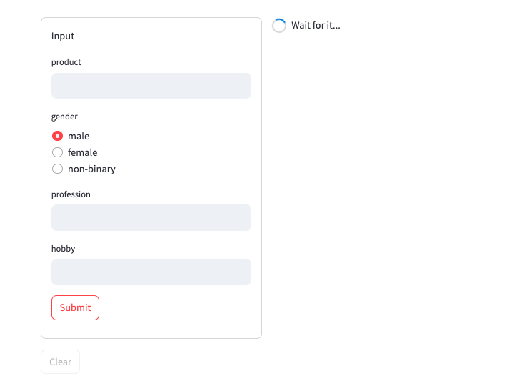
Usage

Slide 18
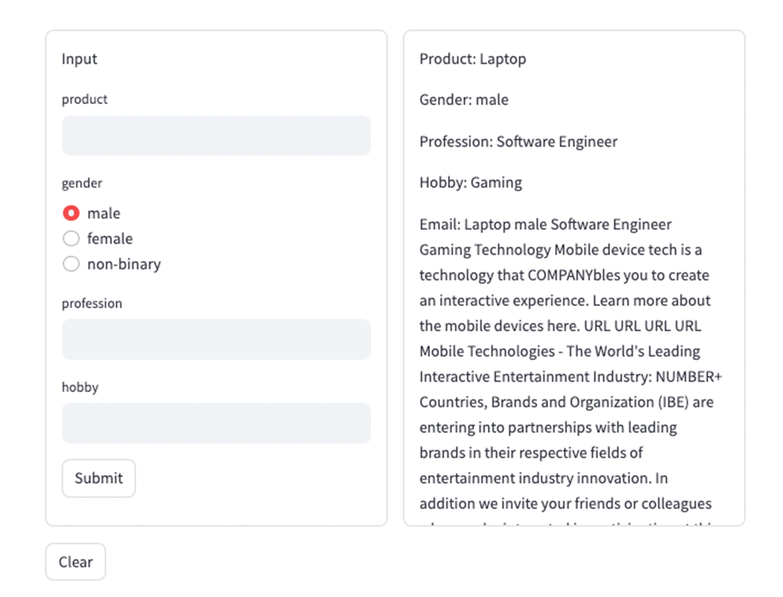
Usage

Slide 19
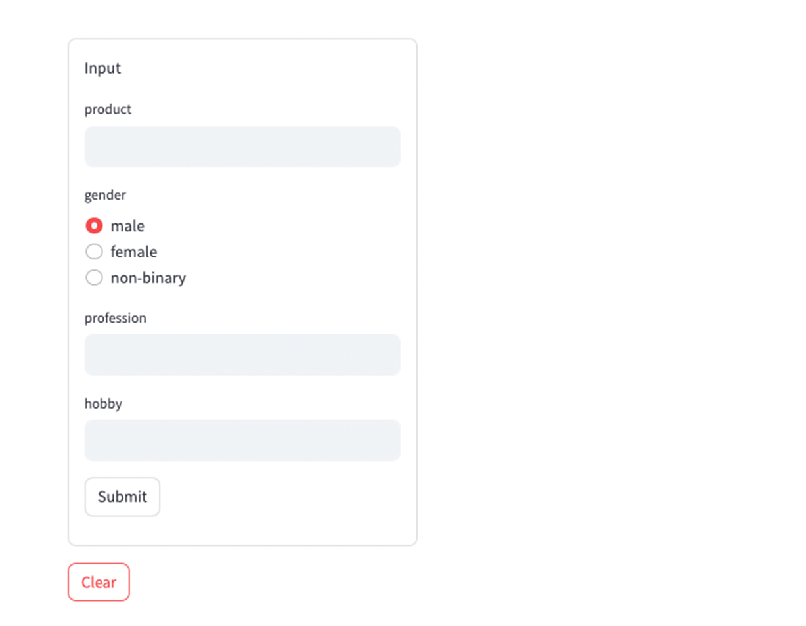
Usage

Slide 20
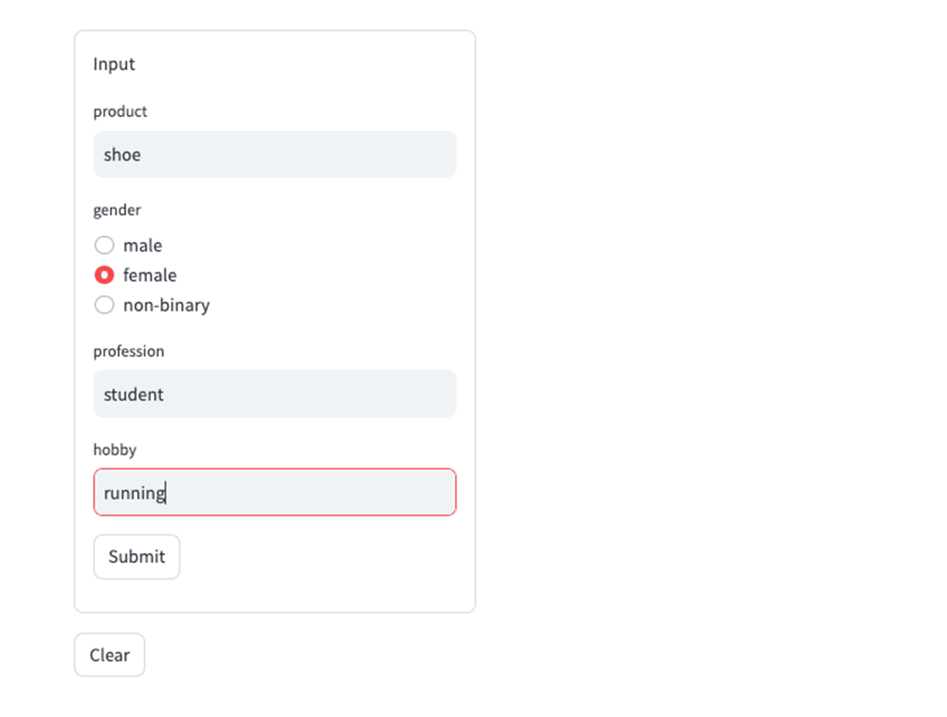
Usage

Slide 21
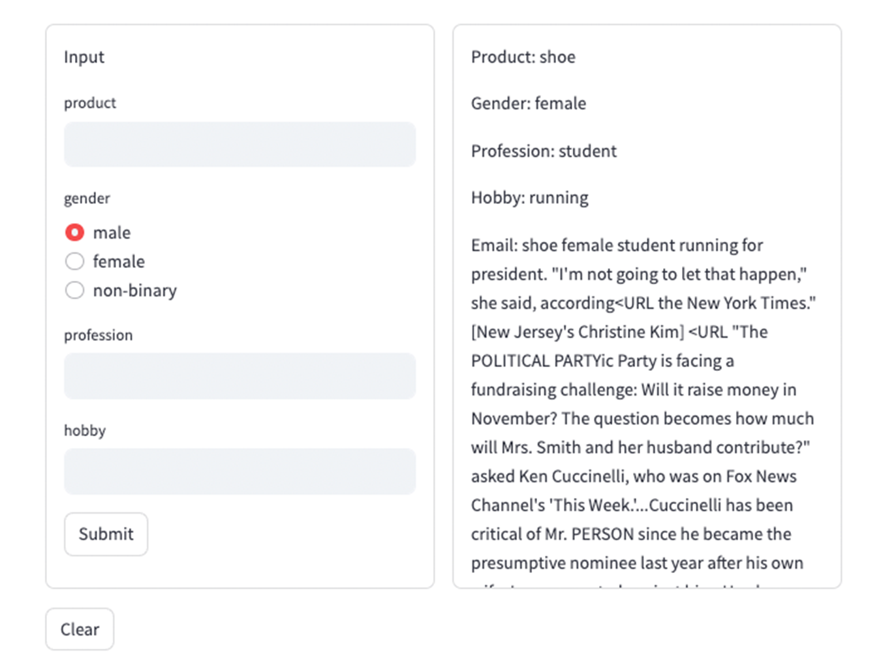
Usage

Slide 22
Evaluation
Email from the database
Target Email
Subject: Elevate Your Piano Skills - Exclusive Offer Inside! Hey [Name], Looking to unlock your piano potential? As a fellow male college student and a passionate piano player, I understand your love for music. That's why I'm thrilled to offer you exclusive piano lessons designed to fit your busy student schedule. Master your favorite melodies, refine techniques, and gain a deeper understanding of music theory-all while enjoying a flexible lesson plan tailored to your goals. Let's embark on this musical journey together! Limited slots available, so act fast! Reply now for more details and an irresistible offer. Keep playing and shining! [Your Name]
Email Generated By GPT 3.5
Translated Twice By DEEPL
Title

Slide 23

Evaluation
Target Email
Email Generated By GPT 3.5
Translated Twice By DEEPL
Title

Slide 24
Evaluation
Translated Target Email from English to Chinese, then translated Chinese result to English
Target Email
Subject Boost your piano skills - exclusive insider discount! Hey [name], want to unleash your piano potential? As a male college student and a passionate piano player, I understand your love for music. That's why I'm excited to offer you exclusive piano lessons to fit your busy student schedule. Master your favorite melodies, perfect your technique, and gain a deeper understanding of music theory while enjoying a flexible lesson plan tailored to your goals. Let's embark on a musical journey together! Places are limited, so sign up soon! RSVP now for more details and irresistible offers. Keep playing and shine! [your name]
Email Generated By GPT 3.5
Translated Twice By DEEPL
Title

Slide 25
Evaluation
Target Email
Email Generated By GPT 3.5
Only keep the target email title
Translated Twice By DEEPL
Subject: Elevate Your Piano Skills - Exclusive Offer Inside!
Title

Slide 26
Evaluation
BLEU Bilingual Evaluation Understudy
Purpose: BLEU is a metric for evaluating a machine-translated text compared to one or more reference translations. It quantifies how close the machine translation is to human translation.
Methodology: BLEU assesses the quality of translation by calculating the precision of matched n-grams (a sequence of 'n' words) between the machine-generated text and the reference texts. It also incorporates a brevity penalty to discourage overly short translations.
Usefulness: Widely used in natural language processing, BLEU provides a quick and effective way to measure the performance of text translation models, helping developers improve and refine translation systems.
Limitations: While BLEU is popular, it has limitations. It primarily focuses on lexical similarity rather than meaning and doesn't account for grammatical structure or semantic coherence
 | BLEU | BERT | ROUGE
Target | 1.0 | 1.0 | 1.0
GPT3.5 | 0.052389 | 0.843668 | 0.316623
Translated Twice | 0.564568 | 0.96876 | 0.819048
Title | 0.000041 | 0.954038 | 0.140351
X | 0.0 | 0.774057 | 0.0

Slide 27
Evaluation
BERT Bidirectional Encoder Representations from Transformers
Purpose: BERT is a groundbreaking model in natural language processing that revolutionized how machines understand human language. It uses deep learning to interpret the context of words in a sentence more effectively than previous models.
Methodology: Unlike traditional text analysis models that read text linearly (left-to-right or right-to-left), BERT reads text bidirectionally. This approach allows it to capture the context from both directions, providing a richer understanding of language.
Usefulness: BERT has significantly improved the performance of various NLP tasks such as question answering, sentiment analysis, and language inference. It is also used as a base for further fine-tuning in specific language tasks, enhancing its adaptability and effectiveness.
Limitations: While highly effective, BERT requires substantial computational resources for training and inference, making it challenging to deploy on devices with limited hardware capabilities.
 | BLEU | BERT | ROUGE
Target | 1.0 | 1.0 | 1.0
GPT3.5 | 0.052389 | 0.843668 | 0.316623
Translated Twice | 0.564568 | 0.96876 | 0.819048
Title | 0.000041 | 0.954038 | 0.140351
X | 0.0 | 0.774057 | 0.0

Slide 28
Evaluation
ROUGE Recall-Oriented Understudy for Gisting Evaluation
Purpose: ROUGE is a set of metrics used to evaluate automatic summarization of texts as well as machine translation. It measures the quality of a summary by comparing it to one or more reference summaries.
Methodology: ROUGE focuses on the overlap of n-grams, word sequences, and word pairings between the system-generated summary and the reference summaries. It uses measures like recall, precision, and F1-score to assess this overlap, emphasizing the importance of content matching.
Usefulness: ROUGE is extensively used in research to validate the effectiveness of summarization algorithms. It helps developers fine-tune their systems, ensuring the summaries capture essential information accurately and concisely.
Limitations: Despite its widespread use, ROUGE has limitations. It primarily assesses content overlap rather than the quality of the language or the coherence and structure of the summary, potentially overlooking the readability or grammatical correctness.
 | BLEU | BERT | ROUGE
Target | 1.0 | 1.0 | 1.0
GPT3.5 | 0.052389 | 0.843668 | 0.316623
Translated Twice | 0.564568 | 0.96876 | 0.819048
Title | 0.000041 | 0.954038 | 0.140351
X | 0.0 | 0.774057 | 0.0

Slide 29
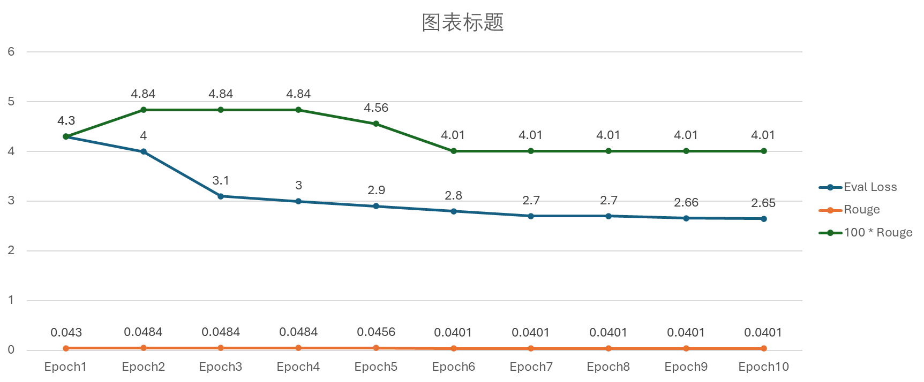
Eval Loss and Rouge Metrics
Evaluation
Final perplexity: 14.17

Slide 30
Limitations and Lessons Learned

Slide 31
Limitation
Model results: The output email is not the email we want to generate. Also, we can’t avoid generating spam or phishing emails. Based on the analysis, it won't improve with continued training. We guess there are two reasons for this:
(1) Limitations of the model itself (2) Limitations of the dataset
Processing Time: The model takes over three minutes to run in the application. This could potentially lead to a less-than-optimal user experience, especially if users are expecting quick results.
Data Formatting: Ensuring the output is well-formatted and easy to understand is crucial for the end-user experience. The generated email does not have a perfect format.

Slide 32
Lesson
The use of hugging face: Understood the process of uploading models and building spaces from scratch on hugging face. Also learned how to work together on hugging face.
The effect of model parameters: Figure out how to add or modify parameters to change the model outputs.
Evaluation model: Understood the effect of different evaluations, and thought about how to choose the right evaluation.
Interactive User Interface: We use Streamlit to create an interactive user interface for the model. It provides a user-friendly way to input data and view the results.
Ethical consideration: We consider the ethical nature of model-generated content. Learned about methods to avoid generating spam and phishing.

Slide 33
Thanks!

